Slide 1

Commercial Real Estate “CRE”
US Commercial Credit Risk Portfolio Management
Quarterly Update
3Q15 Ended September 30, 2015
U.S. Head of Credit & Market Risk

Slide 2
Table of Contents
Section | Topic | Slide No.
Executive Summary | CRE Highlights | 3
 | YTD 9/30/15 – Snapshot of Credit Metrics | 4
Credit Metrics | Credit Exposure Overview | 5
 | Credit Quality Metrics | 6 - 7
 | FEVE Trends | 8 - 9
 | Rating Distribution | 10 - 11
 | New Originations / SCP Exceptions | 12
 | Exceptions Management | 13
P&L | P&L | 14
Next Steps | Next Steps | 15
Appendix | Top 20
 | CRE Concentrations
 | What is CRE Lending
 | Risk ID and Assessments 2014

Slide 3
CRE: Highlights
Positives | Concerns
Record Growth: Year over year the portfolio has grown by 18.8%. | Has the record growth in the portfolio compromised the overall credit quality?
Good credit quality: Classified and criticized loans continue to decline, no non-accruals or entries to NPL are expected. | What effect will a decline the favorable economic conditions have on the portfolio?
Portfolio is well rated: 98% of the portfolio is rated Pass or Low Pass and 90% is No FEVE. | The large concentration of the growth has been new residential multi-family construction.
Geographic Diversification: The bulk of the portfolio is within the Bank’s footprint but CRE has recently expanded into the South Florida market and will go out of footprint for strong / well-known Sponsors.

Slide 4
4
September 2015 YTD Snapshot
($ in Millions)
Note: Budget data as of 3/18/15.

Slide 5
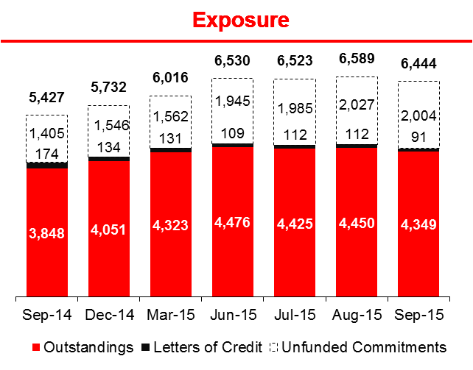
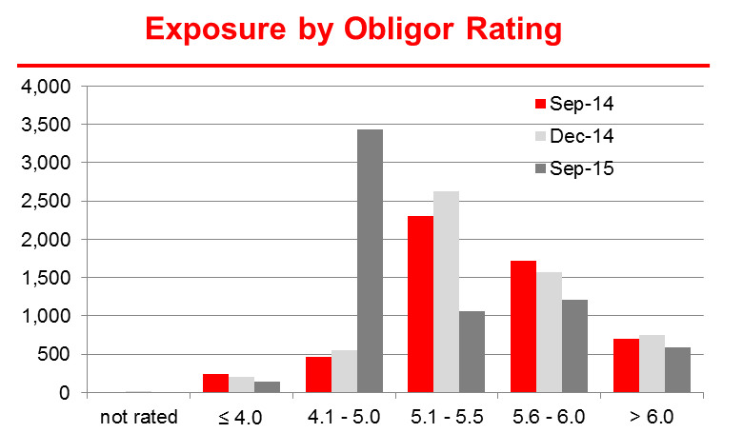
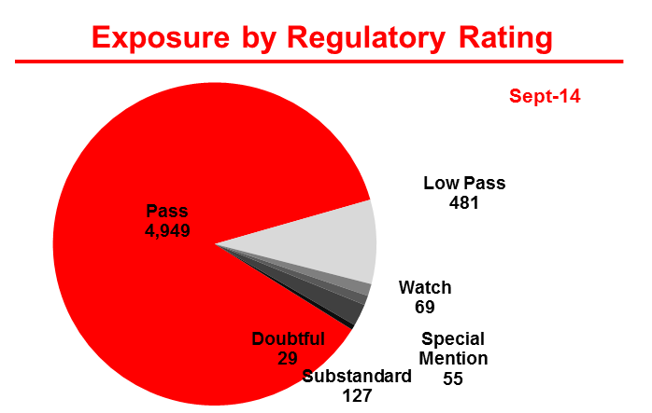
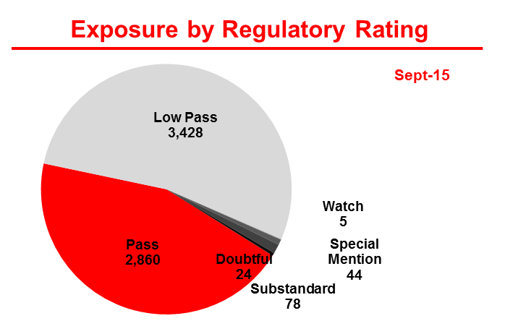
CRE: Credit Exposure Overview
($ in Millions)
The size of the portfolio has decreased slightly in the third quarter. Exposure declined by $86MM in the quarter, outstandings saw a similar decline of $127MM for the same period. The decline is a result of normal amortization and pay-offs.
CRE booked 15 new loans in the third quarter totaling new exposure of $375MM, total booked YTD $1.76 Bn.
Due to a change in the risk rating policy that was implemented earlier this year, the bulk of the portfolio falls in 4.1 to 5.0, therefore, there has been a substantial increase in loans classified as Low Pass (see the chart below).
$6.288MM or 98% of the portfolios binding exposure is rated Pass or Low Pass.
Sources: The Exposure Chart on the top right is based on the 9/30/15 Credit Metrics report. The Exposure by ORR and Regulatory Rating is derived from Monitoring’s FEVE report as of 9/30/15.

Slide 6
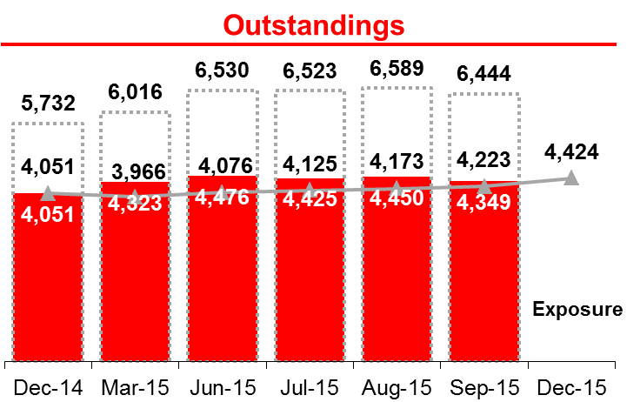
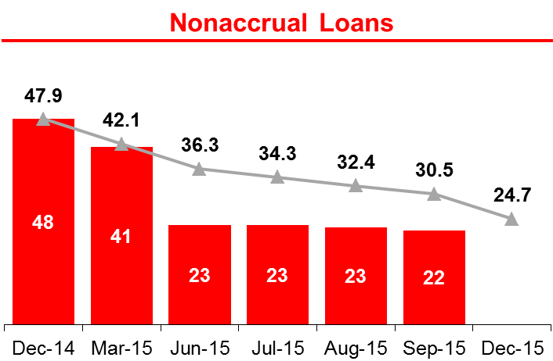
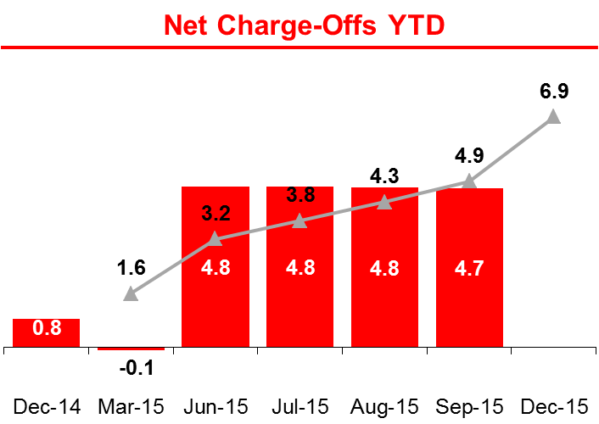
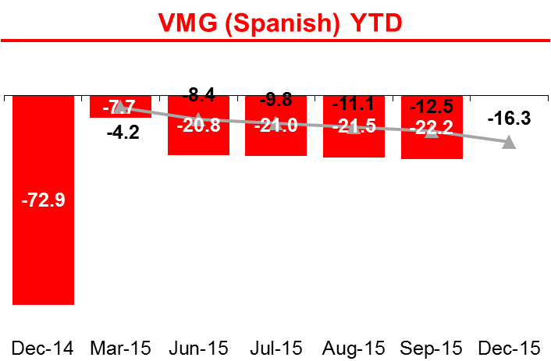
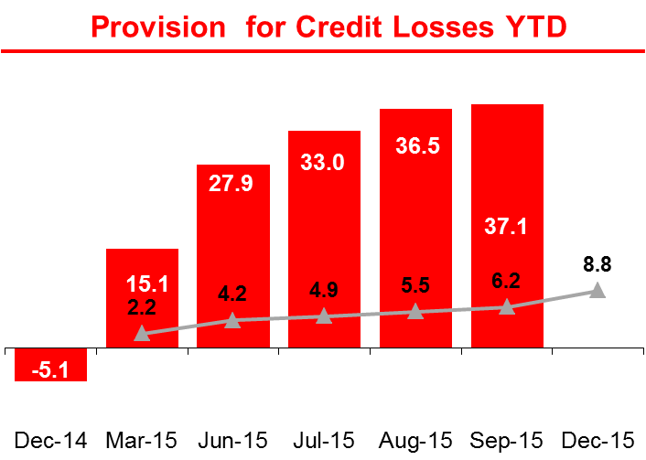
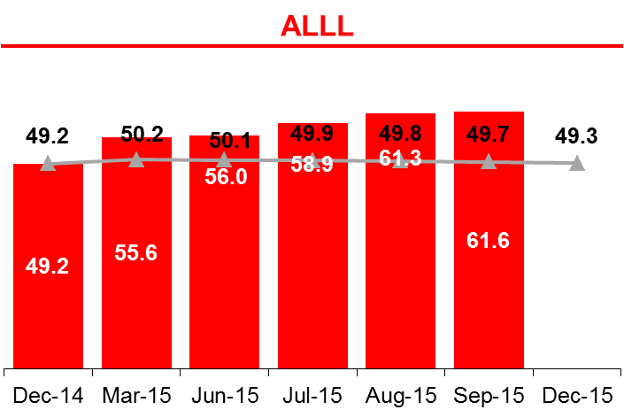
6
CRE: Performance vs. Budget
($ in Millions)
The CRE outstandings continue to outperform it’s budget by $126MM or 3%, this is due to the combination of new loans booked and increased draws under existing commitments.
The increase in Net Charge-Offs was due to a planned note sale in May, the subject was a non-performing (36% leased / 19% occupied) office building in Stamford, CT. The note was sold for $4.98MM, principal balance was $9.13MM.
The updates in the risk rating that were implemented earlier this year are the main driver for the increase in Provision for Credit Losses and ALLL.
Source: SBNA Solvency - Budget data as of 3/18/2015.

Slide 7
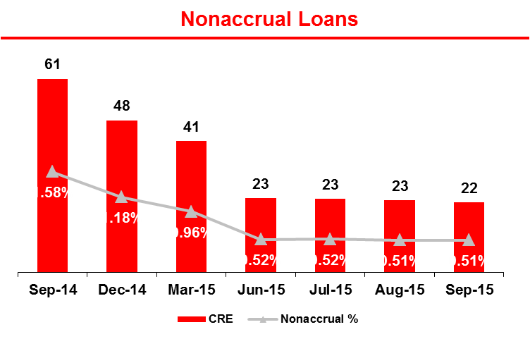
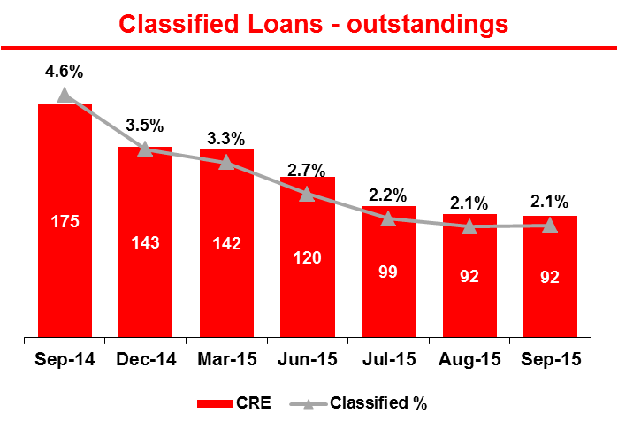
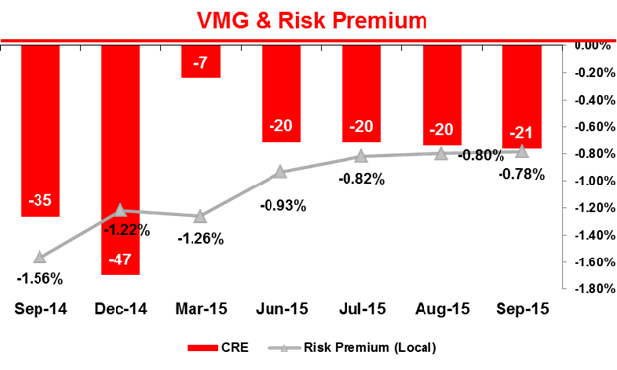
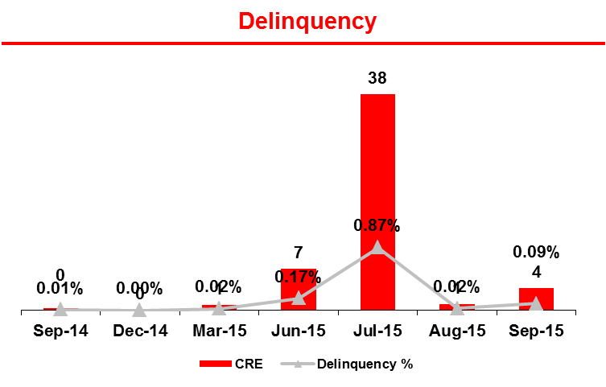
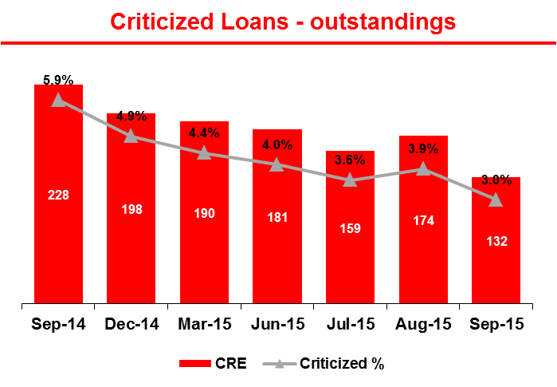
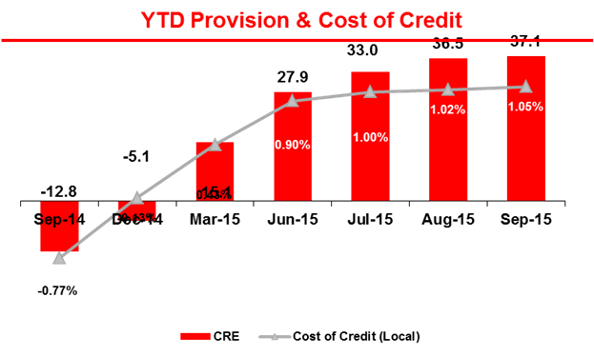
7
CRE: Credit Quality Metrics
($ in Millions)
All categories improved quarter over quarter and year over year. Non-accruals year over year by 64% to $22MM, classified loans declined 47.4% and criticized loans declined 42.1% for the same period. It appears that this decline is a result of improvement in market conditions. As real estate values continue to increase it has allowed many Borrowers that were not able to previously to refinance and take advantage of the current interest rate market.
Over the last year Non-accruals have declined significantly, in September of 2014 ALLL was $39.2MM, which represented 64% of the non-accruals. The decline is due to the improvement in overall market conditions.
There is one potential entry to NPL, $2.2MM C&B Marlborough Associates SRR 1.5 / Extinguish, issues with the principals, demand has been made.
Source: SBNA Credit Metrics as of 9/30/15.
Note: Classified = Substandard + Doubtful + Loss.
Criticized = Classified + Special Mention.
Delinquency refers to 30+ days delinquent.
VMG = Change in Mora (Nonaccrual including L/Cs) + Net Charge-Offs
Cost of Credit = Rolling 12 months Provision / Avg 12 months Usage
Risk Premium = Rolling 12 months VMG / Avg 12 months Usage

Slide 8
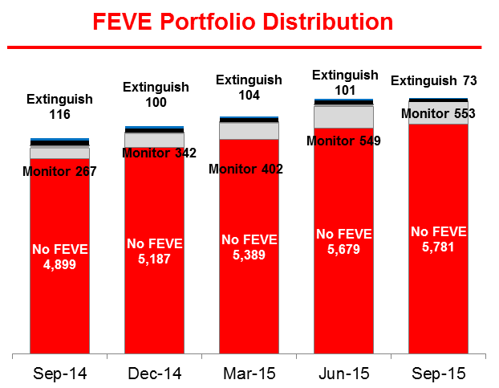
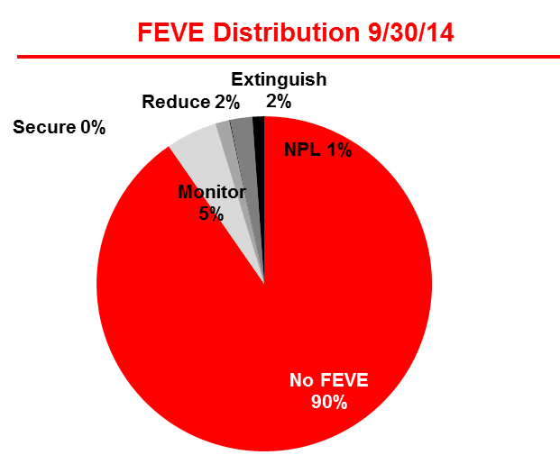
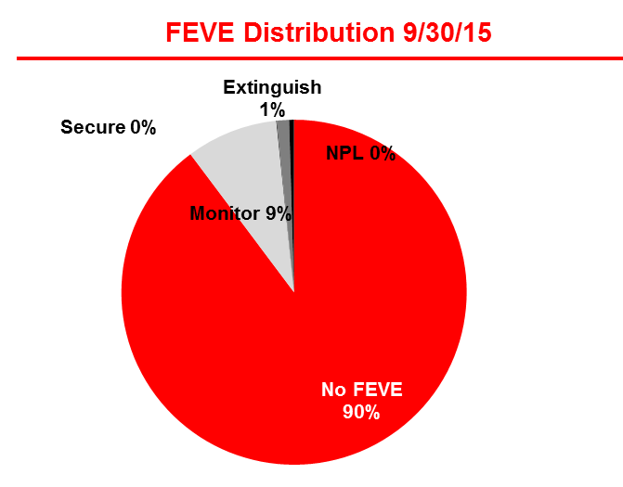
8
CRE: FEVE Trends
($ in Millions)
Portfolio Quality remained stable with 90% of Binding Exposure rated NO FEVE, which was no change from the same period the previous year
The increase in No FEVE and the decline of Extinguish and Monitor indicates the continued strength of the Portfolio.
The largest Extinguish loan in the portfolio was Keystone Sports, this loan was paid in full as of 7/21/2015.
FEVE Status Changes in Q3 2015
Source: FEVE Monitoring Report as of 9/30/15.

Slide 9
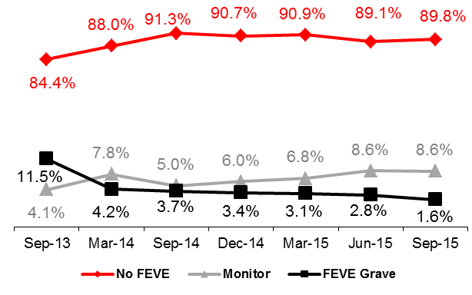
FEVE – Commercial Real Estate
Even though the credit U/W metrics have been loosened to respond to the market demand, the quality of the FEVE CRE portfolio has remained stable as a result of better selectivity of transactions
Source: FEVE Monitoring Reports. All by Binding exposure is $MM – Manual adjustments were made to correct
Inaccurate cost center allocations, leading to variances with the previous slides’ FEVE results on occasion.

Slide 10
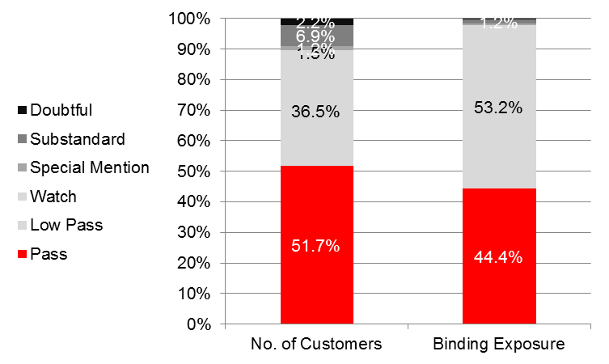
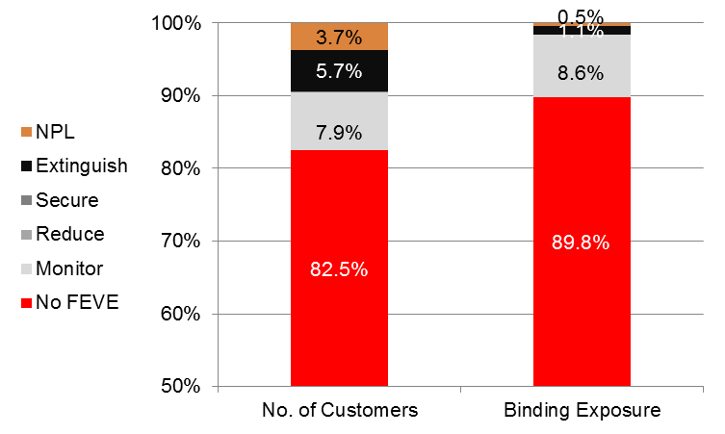
Exposure by Number of Customers
The FEVE and the regulatory ratings are in line, it appears that the larger credits on a dollar basis maintain better credit quality than the smaller ones.
Source: Monitoring FEVE report as of 9/30/2015

Slide 11
ORR vs. FEVE Ratings
Based on the writers review, it appears that the SRR and the FEVE ratings are in line and they are adequately reflecting the risks within the portfolio.
Source: Monitoring FEVE report as of 9/30/2015.

Slide 12
12
CRE: New Originations - SCP Exceptions
($ in Millions)
The above exceptions noted are for the period ended 8/31/2015.

Slide 13
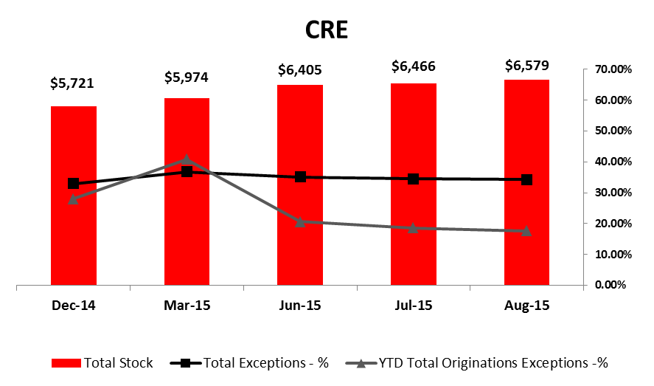
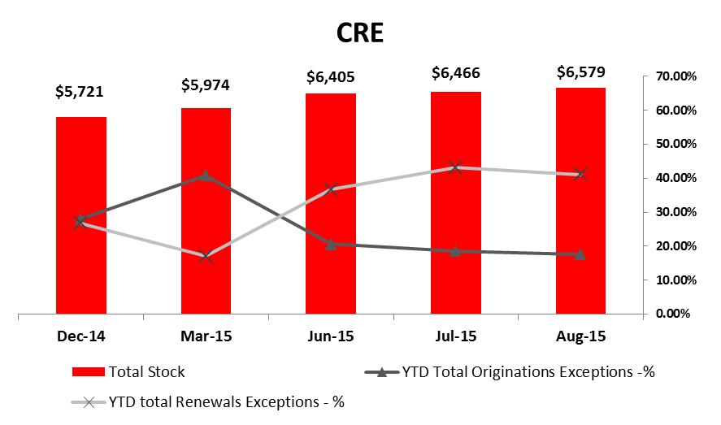
CRE: Exception Management
($ in Millions)
CRE accounts for a relatively large amount of exceptions (29.0%) based on the size of the portfolio (10.4%).
Of the exceptions reported on a facility level as of YTD 8/30/2015, all are related to Underwriting Guideline exceptions.
Per the CRE Regional Credit Officer, the high amount of exceptions can be attributed to the legacy portfolio as loans are booked with the exceptions and these exceptions are often not cleared unless the loan is modified or re-booked.
Source: CCMIS by Binding Exposure. “BANK” refers to SBNA without Retail, Small Business Banking, and runoff.
NOTE: The overview does not include Obligor specific exceptions, such as “Sensitive Lending”. ALSO NOTE that the Bank is in the process of cleaning up exceptions that are no longer exceptions as per the updated underwriting guidelines and cred it policy.

Slide 14
P&L Performance
Source: 2014 Actual results were provided by Finance. 2015 Budget data were taken from the most recent CRE SCP.
The portfolio is 6% ahead of plan for both revenues and fees, operating expenses are expected to decline by 10%, with provisions increasing by 136% and taxes declining by 22.9%.
The increase in revenues coupled with the decline is expenses including taxes was not enough to offset the increase in provisions, therefore, negatively impacting net income by 25.7%.
The increase in ALLL over budget is due to the change in the risk rating policy.

Slide 15
Open Regulatory, Internal Audit, and Loan Review Issues - Tracking
MRA /RPA | DESCRIPTION / CONCLUSION | STATUS | TARGET DATE
MRA: Risk Rating Integrity | Revised Risk Rating Methodology that places greater emphasis on objective measures of a Borrower’s current and prospective financial condition including cash flow, profitability, liquidity and solvency. | Done | 4/30/2015
MRA: Credit Administration | Modify primary loan approval document to provide a comprehensive, succinct summary of the key risks, mitigates, transaction rationale and risk rating justification. | Done | 5/31/2015
MRA: Quality of MIS and Level of Portfolio Analytics | Develop comprehensive portfolio analytics | Done | 6/30/2015
Source: Internal Audit Report as of 6/30/2015

Slide 16
Next Steps
ISSUE | PROPOSED ACTION PLAN | RESOURCES | Target Date
Market pressures. | Due to increased market pressures underwriting standards continue to be squeezed. Continue to work with all areas of the Bank to continue to maintain portfolio quality, while continuing to grow the portfolio. | Portfolio Management; Line; CPs; Risk | On going
New Risk Rating Methodology | Continue to work with all parties on the testing and implementation of the new risk rating system. | Portfolio Management; CPs; Risk | On going
Exceptions to Policy | Typically once loans are booked with exceptions they are not cleared unless the loan is rebooked or modified. Therefore, a process needs to be put in place to clear these exceptions either through a interim or the annual review. | Portfolio Management; CPs; Risk | On going
New Loan Originations Report | Work with MIS and the Business Lines on the creation of a origination report that accurately reflects all new business closed. | Portfolio Management MIS CPs | Completed

Slide 17
APPENDIX
Top 20
CRE Concentrations
What is CRE Lending
Risk ID and Assessment 2014

Slide 18
CRE: Top 20
($ in Millions)
The Top 20 relationships have binding exposure of $2.04MM.
The Top 20 accounts for 31.7% of CRE Binding Exposure.
Philadelphia Management Company is an addition to the Top 20. In August a new $60MM construction loan was originated. The loan is to finance the construction of 247 residential units in Philadelphia’s “Old City” neighborhood.
Source: Monitoring FEVE report as of 9/30/2015.

Slide 19
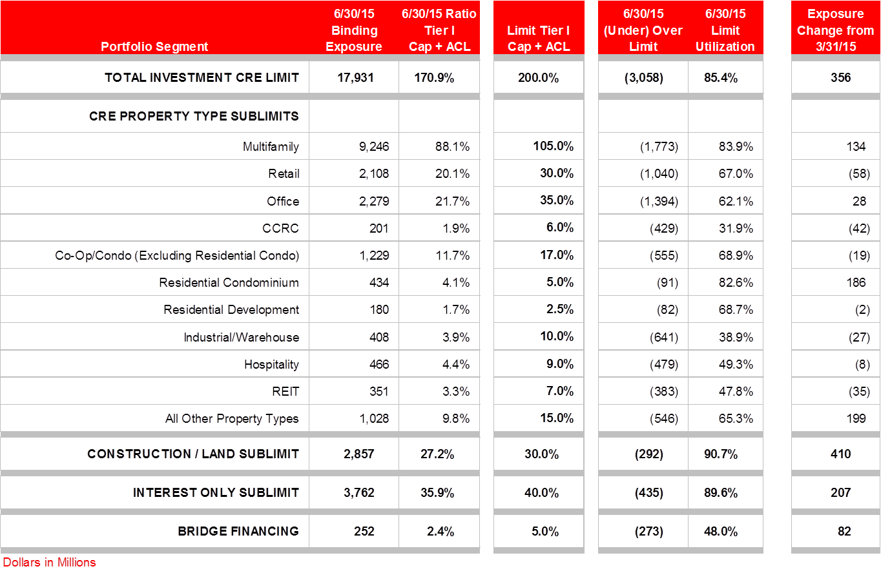
Commercial Real Estate Concentrations
The CRE Construction Portfolio is well managed and sound. In response to current market conditions the construction sublimit was raised from 25% to 30% of Tier 1 Capital + ACL. This increase will allow the Bank to be more inline with their peer group. The peer average for funded construction loans was 10.6% with SAN at 10.1%. SAN CRE will continue to be competitive and court the best customers with strong track records, while not compromising underwriting and risk standards.
Of note, the above is based on 6/30/2015 information as updated concentration levels are in the process of being approved.

Slide 20
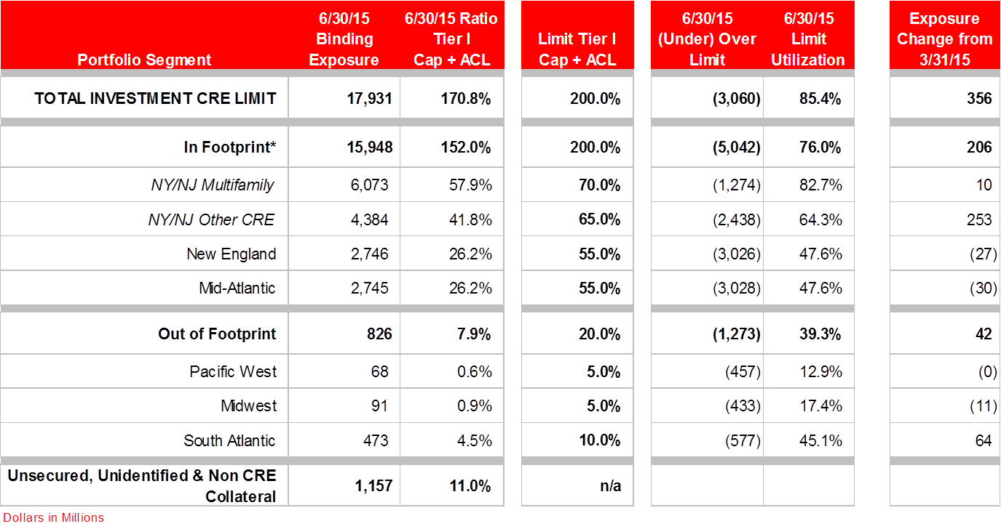
Commercial Real Estate Geographic Concentrations
Below is a break down of CRE by geography, 80% of the portfolio is located in footprint, 20% is located out of footprint (5% - Pacific West, 5% - Midwest, 10% - South Atlantic). The loans within the footprint appear to well diversified across the different markets.
Of note, the above is based on 6/30/2015 information as updated concentration levels are in the process of being approved.

Slide 21
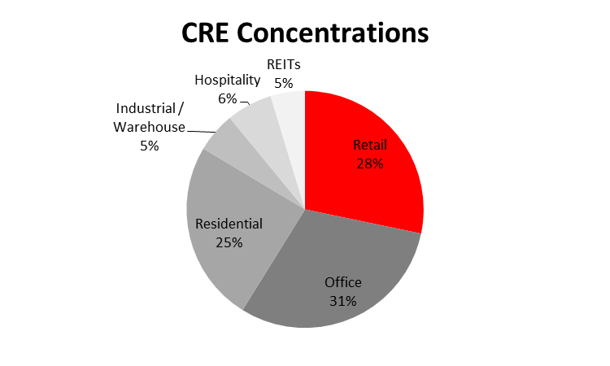
CRE: What is Commercial Real Estate Lending?
Commercial Real Estate (“CRE”) - are loans where the primary source of repayment is derived from the cash flow of the real estate. Preferred product types include construction and term lending to retail, office and multi-family. On a more selective basis the Bank will lend to other product types including hospitality, condominiums, industrial/warehouse and self-storage.
Markets & Growth:
New England, maintain position with moderate growth forecasted;
NY, DC & Philadelphia, increase presence in these markets, addition of 3 RMs in 2015;
South Florida, increase presences in this market, addition of 2 RMs in 2015;
Additionally, selective growth outside of the Northeast with existing clients and key prospects.
Products Offered:
Construction loans
Term loans
REITs
Lines of credit
Bridge Loans
Target Clients of the Bank include:
Well capitalized individuals, LLCs or institutional ownership clients;
Single transactions are typically $25MM.

Slide 22
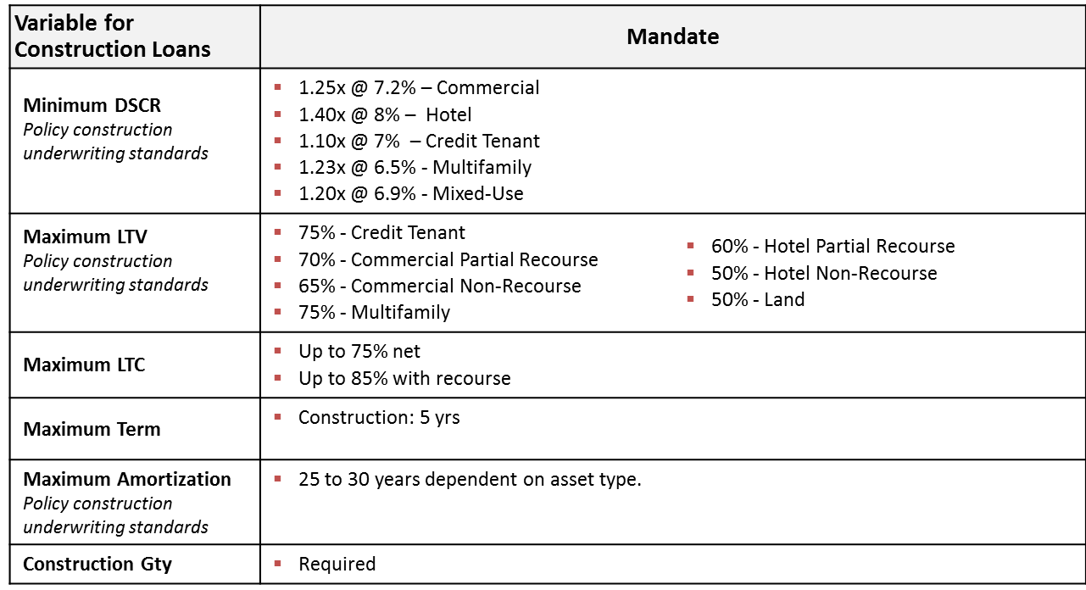
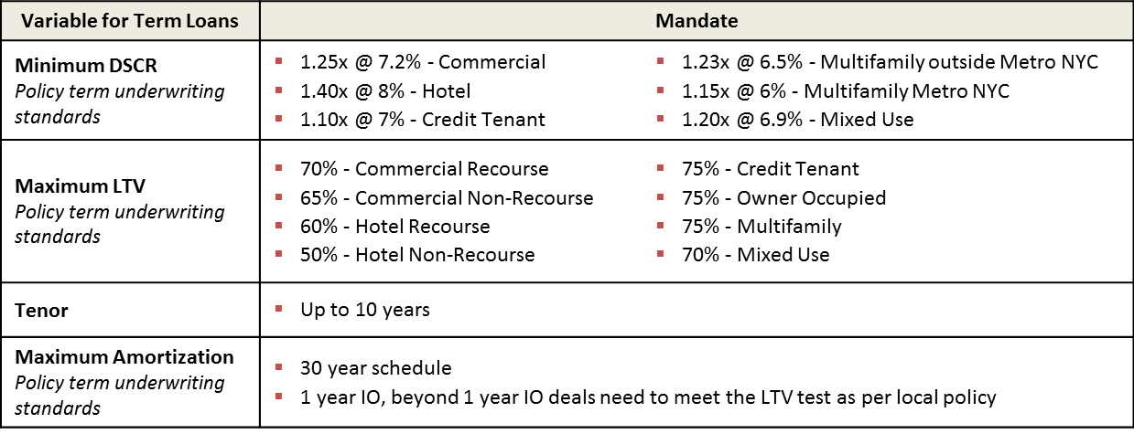
CRE: What is Commercial Real Estate Lending?

Slide 23
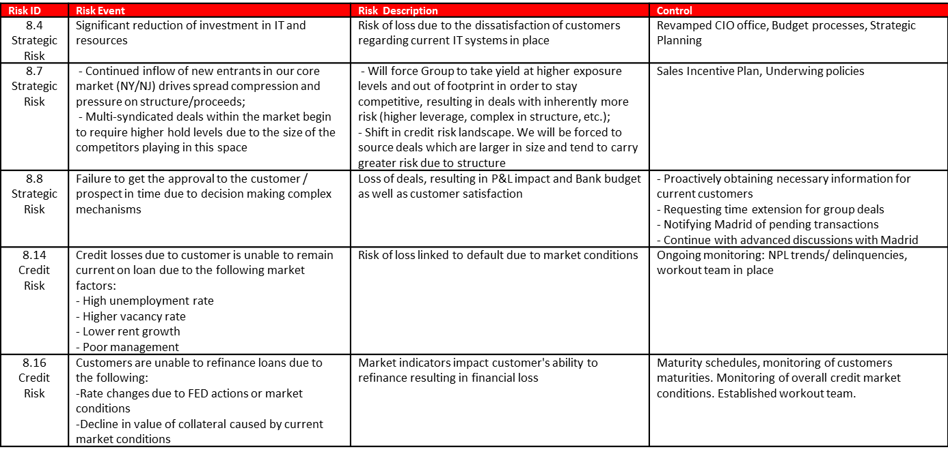
CRE: Risk ID and Assessment 2014 (1 of 2)

Slide 24
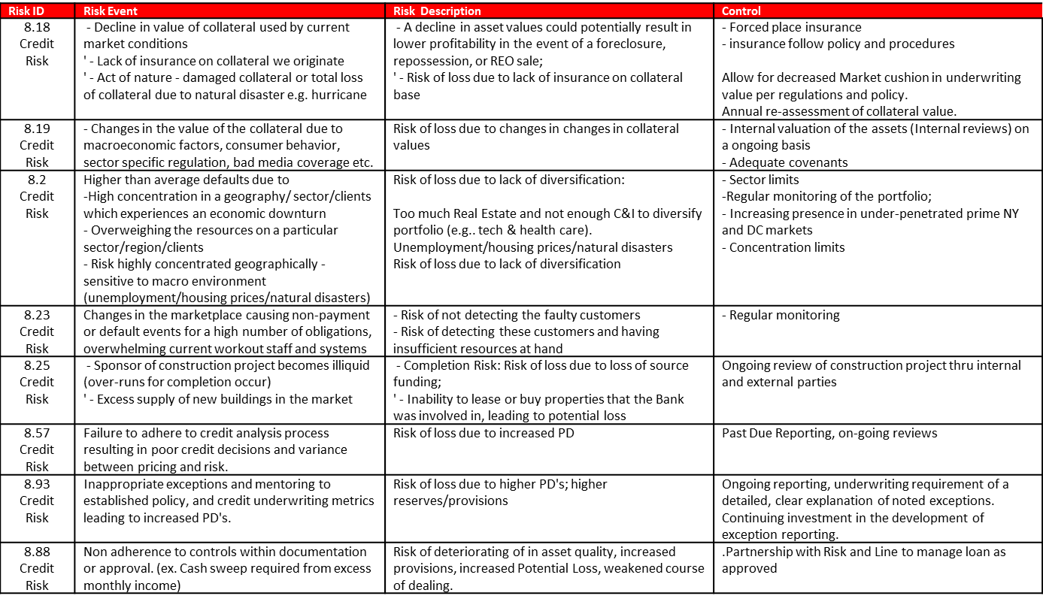
CRE: Risk ID and Assessment 2014 (2 of 2)

Slide 25
Notes:
25

